Slide 1
Continuous Integration
Overview
v1.0 - 20200501

Slide 2
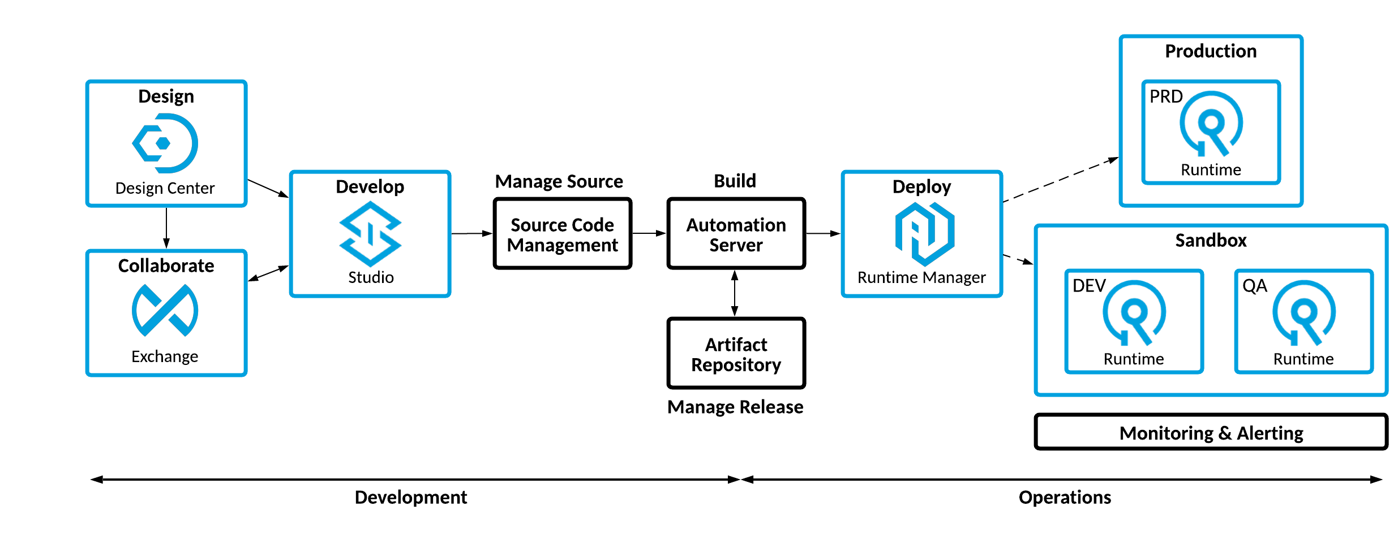
Build & Deploy Automation
Build
Deploy

Slide 3
Continuous Integration
Continuous Integration is a development practice that allows developers to integrate code into a shared repository several times a day.
Automation: Each check-in is verified by an automated build and the execution of a regression test suite.
Every Build is a Potential Release: Every code change has the potential of being released into Production.
Failing Fast: Any failures during the build and regression test process can be identified immediately and quickly resolved by the development team.

Slide 4
Continuous Integration
using SCM Branching

Slide 5
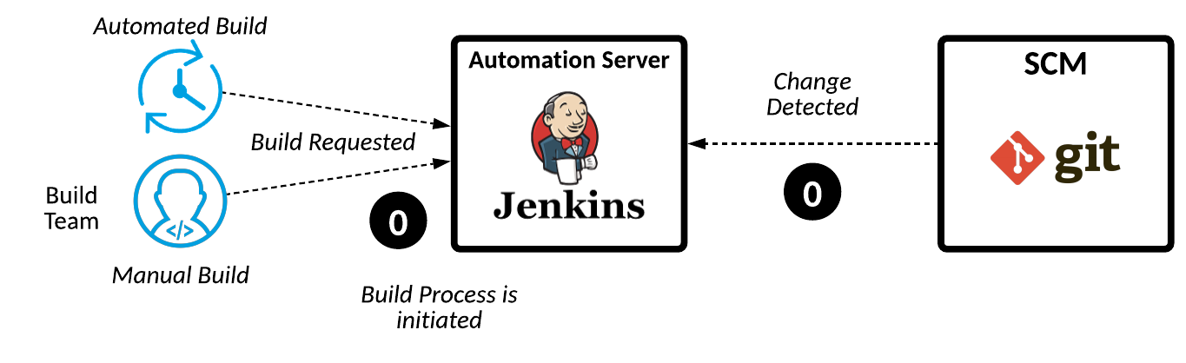
Step 0: Trigger a Build

Slide 6
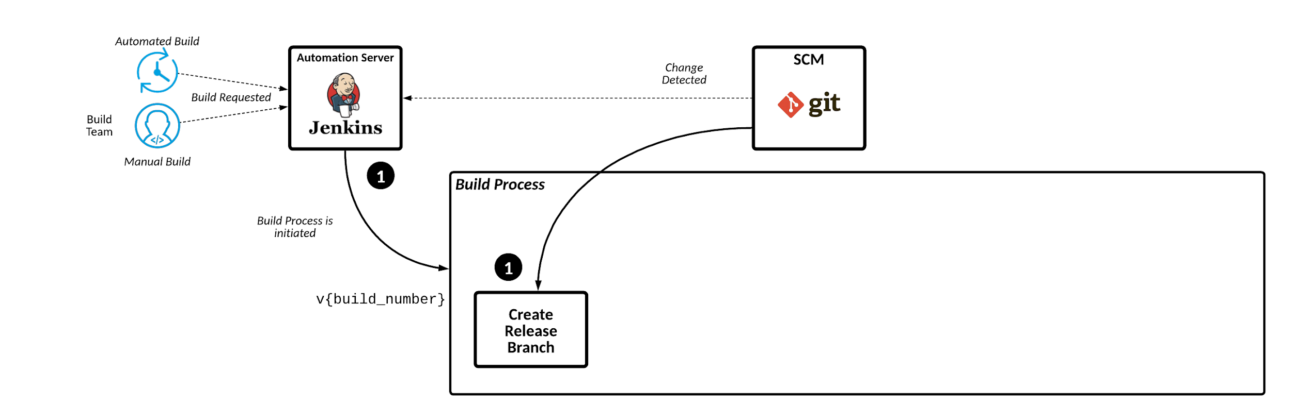
Step 1: Create the Release Branch

Slide 7
Step 1: Jenkins Pipeline
stage('Create Release Branch') { steps { echo "Starting Create Release Branch..." sh "git checkout -b '${env.BUILD_VERSION}'" sh "mvn versions:set -DnewVersion='${env.BUILD_VERSION}'" echo "Create Release Branch: ${currentBuild.currentResult}" } post { success { echo "...Create Release Branch Succeeded for ${env.BUILD_VERSION}: ${currentBuild.currentResult}" } unsuccessful { echo "...Create Release Branch Failed for ${env.BUILD_VERSION}: ${currentBuild.currentResult}" } } }
1

Slide 8
Step 1: Jenkins Pipeline
stage('Create Release Branch') { steps { echo "Starting Create Release Branch..." sh "git checkout -b '${env.BUILD_VERSION}'" sh "mvn versions:set -DnewVersion='${env.BUILD_VERSION}'" echo "Create Release Branch: ${currentBuild.currentResult}" } post { success { echo "...Create Release Branch Succeeded for ${env.BUILD_VERSION}: ${currentBuild.currentResult}" } unsuccessful { echo "...Create Release Branch Failed for ${env.BUILD_VERSION}: ${currentBuild.currentResult}" } } }
2

Slide 9
Step 1: Jenkins Pipeline
stage('Create Release Branch') { steps { echo "Starting Create Release Branch..." sh "git checkout -b '${env.BUILD_VERSION}'" sh "mvn versions:set -DnewVersion='${env.BUILD_VERSION}'" echo "Create Release Branch: ${currentBuild.currentResult}" } post { success { echo "...Create Release Branch Succeeded for ${env.BUILD_VERSION}: ${currentBuild.currentResult}" } unsuccessful { echo "...Create Release Branch Failed for ${env.BUILD_VERSION}: ${currentBuild.currentResult}" } } }
3

Slide 10
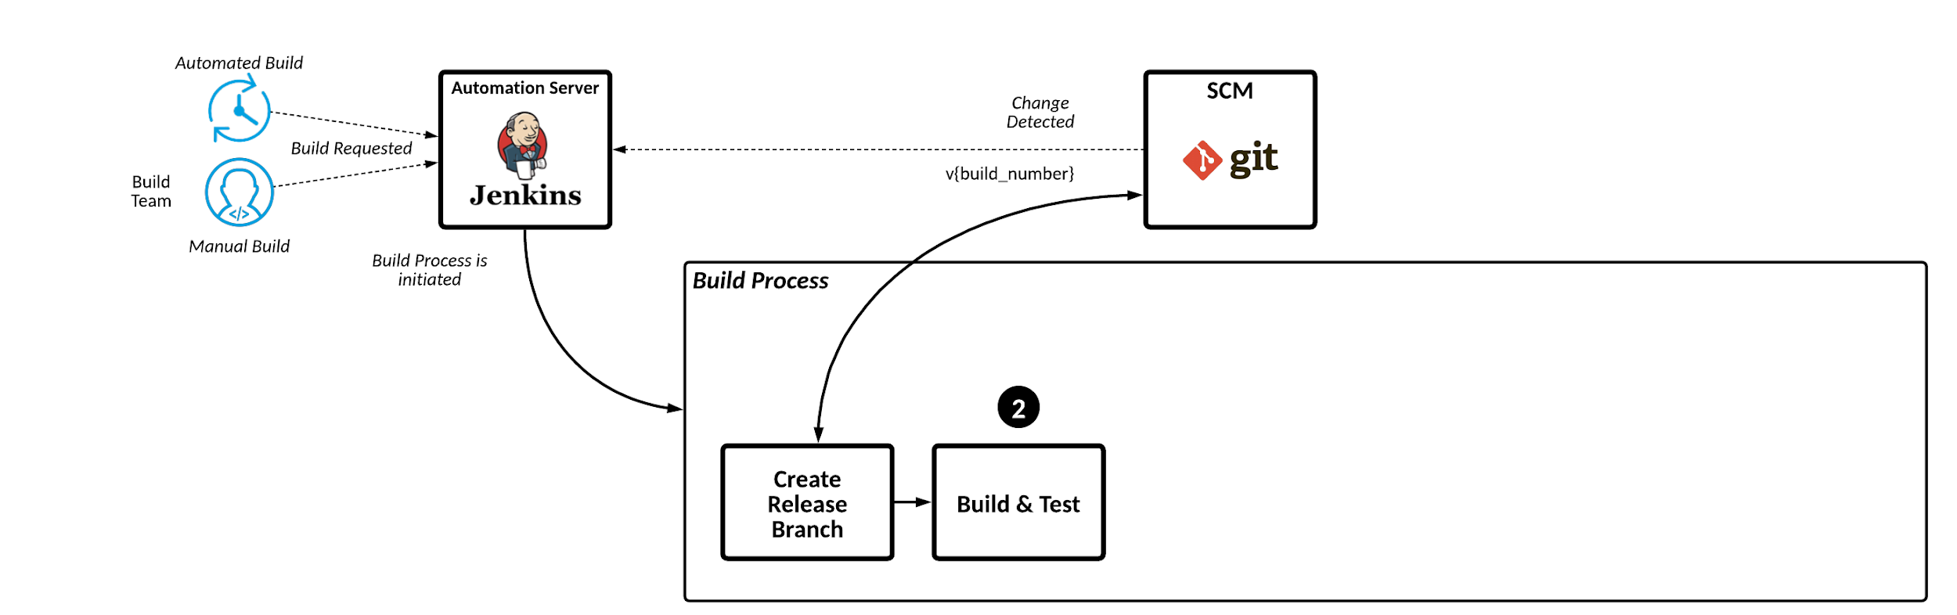
Step 2: Build & Test

Slide 11
Step 2: Jenkins Pipeline
stage('Build and Test') {
steps { echo "Starting Build and Test..." sh "mvn clean verify" echo "Build and Test: ${currentBuild.currentResult}"
} post { success { echo "...Build and Test Succeeded for ${env.BUILD_VERSION}: ${currentBuild.currentResult}" } unsuccessful { echo "...Build and Test Failed for ${env.BUILD_VERSION}: ${currentBuild.currentResult}" script { dropLocalReleaseBranch() } } } }
1

Slide 12
Step 2: Jenkins Pipeline
stage('Build and Test') {
steps { echo "Starting Build and Test..." sh "mvn clean verify" echo "Build and Test: ${currentBuild.currentResult}"
} post { success { echo "...Build and Test Succeeded for ${env.BUILD_VERSION}: ${currentBuild.currentResult}" } unsuccessful { echo "...Build and Test Failed for ${env.BUILD_VERSION}: ${currentBuild.currentResult}" script { dropLocalReleaseBranch() } } } }
2

Slide 13
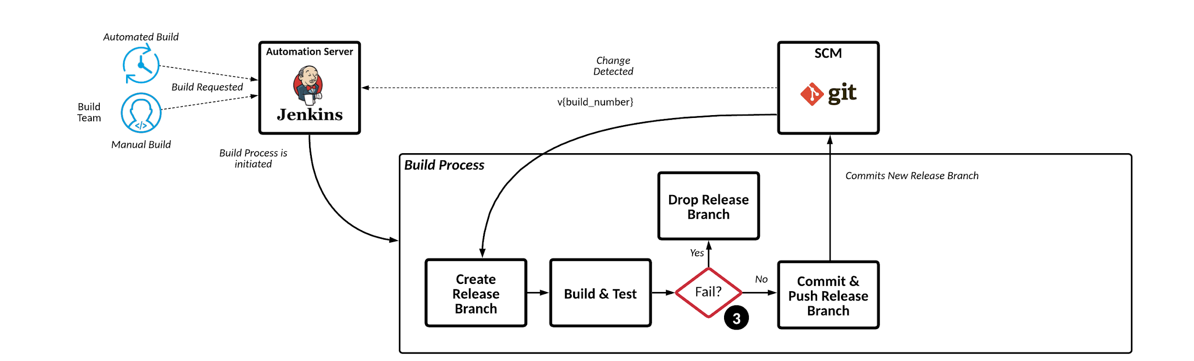
Step 3: Push/Drop Release Branch

Slide 14
Step 3: Jenkins Pipeline
stage('Push Release Branch') { steps { script { echo "Starting Push Release Branch..." // Success sh "git add pom.xml" sh 'git commit -m "Committing Branch"' sh "git push --set-upstream origin '${env.BUILD_VERSION}'" echo "Build Successful...branch ${env.BUILD_VERSION} committed" } } post { success { echo "...Push Release Branch Succeeded for ${env.BUILD_VERSION}: ${currentBuild.currentResult}" } unsuccessful { echo "...Push Release Branch Failed for ${env.BUILD_VERSION}: ${currentBuild.currentResult}" } } }
1

Slide 15
Step 3: Jenkins Pipeline
void dropLocalReleaseBranch() { echo "Starting Drop Local Release Branch: ${env.BUILD_VERSION} ..." sh "git checkout develop" sh "git branch -d '${env.BUILD_VERSION}'" echo "...Local Release Branch ${env.BUILD_VERSION} Dropped" }
2

Slide 16
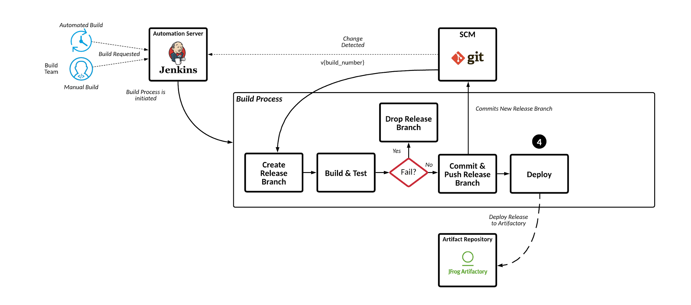
Step 4: Deploy

Slide 17
Step 4: Jenkins Pipeline
stage('Deploy Artifact') { steps { script { echo "Starting Deploy Artifact..." configFileProvider([configFile(fileId: '107138b1-fdbe-45c5-8eb3-64a520257c07', targetLocation: 'settings.xml', variable: 'MAVEN_SETTINGS_XML')]) { sh 'mvn -U --batch-mode -s $MAVEN_SETTINGS_XML install deploy' } echo "Artifact Deployed: ${currentBuild.currentResult}" } } post { success { echo "...Deploy Artifact Succeeded for ${env.BUILD_VERSION}: ${currentBuild.currentResult}" } unsuccessful { echo "...Deploy Artifact Failed for ${env.BUILD_VERSION}: ${currentBuild.currentResult}" } } }
1

Slide 18
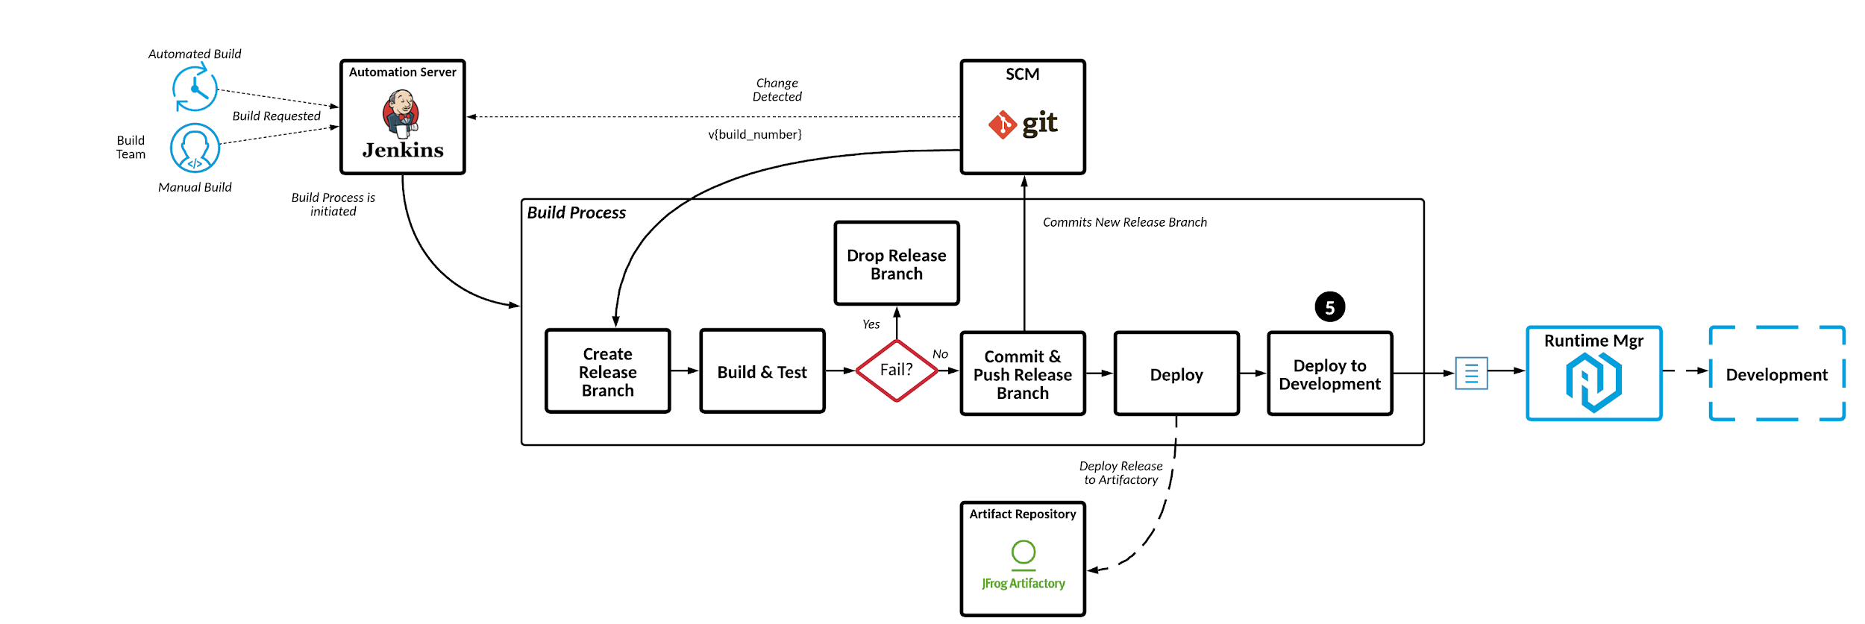
Step 5: Deploy to Development

Slide 19
Step 5: Jenkins Pipeline
stage('Deploy to Development') { steps { script { echo "Starting Deploy to Development" applicationName = readMavenPom().getArtifactId() echo "applicationName=${applicationName}" props = readProperties(file: '/tmp/Jenkins/esapi/deploy.properties')
// set properties
} configFileProvider([configFile(fileId: '107138b1-fdbe-45c5-8eb3-64a520257c07', targetLocation: 'settings.xml', variable: 'MVNS')]) { sh """ mvn -U --batch-mode -s $MAVEN_SETTINGS_XML \ -Dmule.version=${anypointMuleVersion}
-Danypoint.mule.environment=${anypointMuleEnvironment} \ -Danypoint.username=${anypointUsername} \ -Danypoint.password=${anypointPassword} \ -Dcloudhub.workerType=${cloudhubWorkerType} \ -Dcloudhub.workers=${cloudhubWorkers} \ -Dcloudhub.env.client_id=${cloudhubEnvClientID} \ -Dcloudhub.env.client_secret=${cloudhubEnvSecretID} \ mule:deploy -DmuleDeploy -P cloudhub """ } } post { success {
echo "...Deployment Succeeded for ${env.BUILD_VERSION}: ${currentBuild.currentResult}" } unsuccessful {
echo "...Deployment Failed for ${env.BUILD_VERSION}: ${currentBuild.currentResult}"
} }
}
1

Slide 20
Step 5: Jenkins Pipeline
stage('Deploy to Development') { steps { script { echo "Starting Deploy to Development" applicationName = readMavenPom().getArtifactId() echo "applicationName=${applicationName}" props = readProperties(file: '/tmp/Jenkins/esapi/deploy.properties')
// set properties
} configFileProvider([configFile(fileId: '107138b1-fdbe-45c5-8eb3-64a520257c07', targetLocation: 'settings.xml', variable: 'MVNS')]) { sh """ mvn -U --batch-mode -s $MAVEN_SETTINGS_XML \ -Dmule.version=${anypointMuleVersion}
-Danypoint.mule.environment=${anypointMuleEnvironment} \ -Danypoint.username=${anypointUsername} \ -Danypoint.password=${anypointPassword} \ -Dcloudhub.workerType=${cloudhubWorkerType} \ -Dcloudhub.workers=${cloudhubWorkers} \ -Dcloudhub.env.client_id=${cloudhubEnvClientID} \ -Dcloudhub.env.client_secret=${cloudhubEnvSecretID} \ mule:deploy -DmuleDeploy -P cloudhub """ } } post { success {
echo "...Deployment Succeeded for ${env.BUILD_VERSION}: ${currentBuild.currentResult}" } unsuccessful {
echo "...Deployment Failed for ${env.BUILD_VERSION}: ${currentBuild.currentResult}"
} }
}
2

Slide 21
Step 5: Jenkins Pipeline
stage('Deploy to Development') { steps { script { echo "Starting Deploy to Development" applicationName = readMavenPom().getArtifactId() echo "applicationName=${applicationName}" props = readProperties(file: '/tmp/Jenkins/esapi/deploy.properties')
// set properties
} configFileProvider([configFile(fileId: '107138b1-fdbe-45c5-8eb3-64a520257c07', targetLocation: 'settings.xml', variable: 'MVNS')]) { sh """ mvn -U --batch-mode -s $MAVEN_SETTINGS_XML \ -Dmule.version=${anypointMuleVersion}
-Danypoint.mule.environment=${anypointMuleEnvironment} \ -Danypoint.username=${anypointUsername} \ -Danypoint.password=${anypointPassword} \ -Dcloudhub.workerType=${cloudhubWorkerType} \ -Dcloudhub.workers=${cloudhubWorkers} \ -Dcloudhub.env.client_id=${cloudhubEnvClientID} \ -Dcloudhub.env.client_secret=${cloudhubEnvSecretID} \ mule:deploy -DmuleDeploy -P cloudhub """ } } post { success {
echo "...Deployment Succeeded for ${env.BUILD_VERSION}: ${currentBuild.currentResult}" } unsuccessful {
echo "...Deployment Failed for ${env.BUILD_VERSION}: ${currentBuild.currentResult}"
} }
}
3

Slide 22
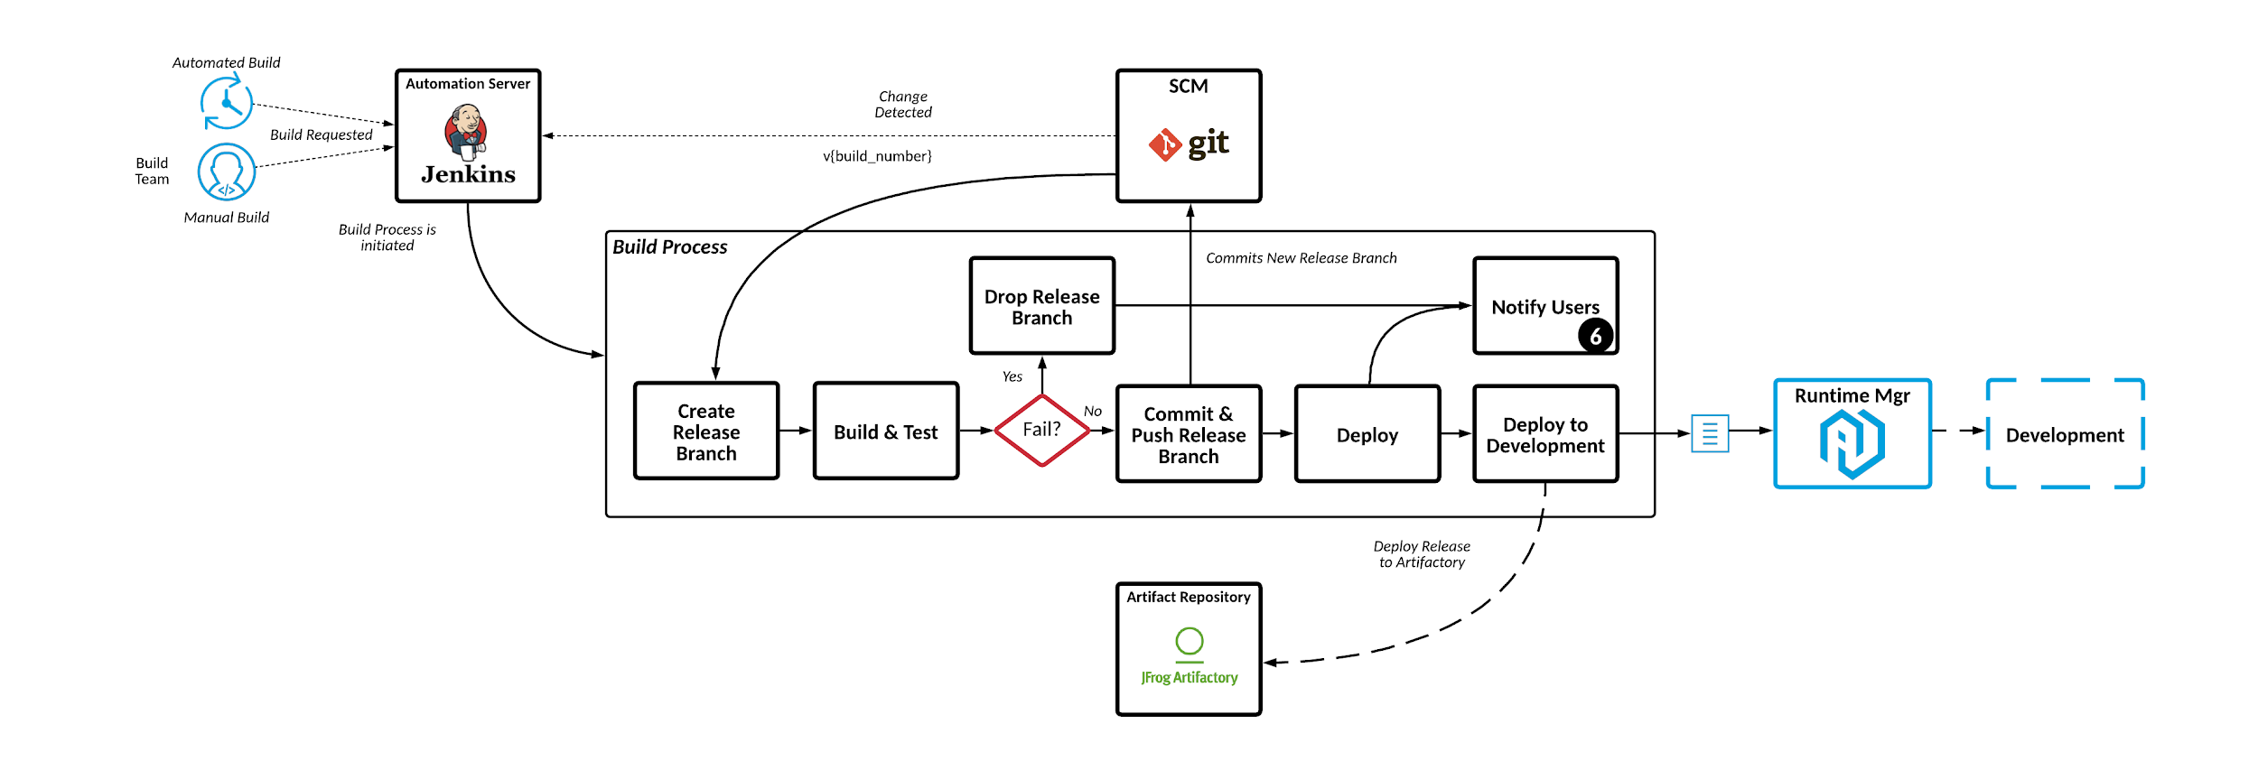
Step 6: Notify Users

Slide 23
In Conclusion

Slide 24
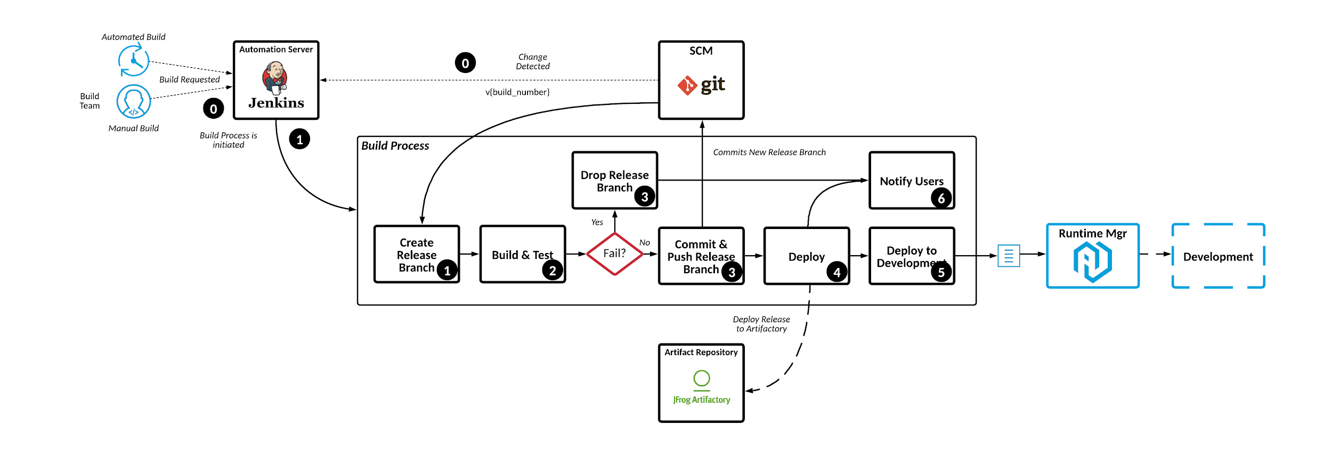
Continuous Integration

Slide 25
Thank you

